Slide 1
TITLE PAGE, SCHOOL NAME, LOGO, SCHOOL IDENTITY DESIGN-COLOR

Slide 2
PART_I_A__COMMITMENT_TO_ORGANIZATIONAL_OUTCOMES
Physical & Financial Accomplishment Report
School Leadership and Administration
Obj. 1: Developed School Improvement Plan (SIP) aligned with the Division Education Development Plan (DEDP) and PREXC targets.
PAPs | PHYSICAL ACCOMPLISHMENTS |  |  |  |  |  |  | FINANCIAL ACCOMPLISHMENTS |  |  |  |  | MOVs
 | Targets | Accomplishments | Gain (if any) | Gap (if any) | Total Accomplishment | % of Accomplishments | Remarks | Targets | Actual Accomplishments | Variance | % of Accomplishments | Remarks
 |  |  |  |  |  |  |  |  |  |  |  |  | Provide a hyperlink to view the MOVs
 |  |  |  |  |  |  |  |  |  |  |  |  | Provide a hyperlink to view the MOVs

Slide 3
PART_I_A__COMMITMENT_TO_ORGANIZATIONAL_OUTCOMES
Physical & Financial Accomplishment Report
School Leadership and Administration
Obj. 2: Implemented SIP through the Annual Implementation Plan (AIP).
PAPs | PHYSICAL ACCOMPLISHMENTS |  |  |  |  |  |  | FINANCIAL ACCOMPLISHMENTS |  |  |  |  | MOVs
 | Targets | Accomplishments | Gain (if any) | Gap (if any) | Total Accomplishment | % of Accomplishments | Remarks | Targets | Actual Accomplishments | Variance | % of Accomplishments | Remarks
 |  |  |  |  |  |  |  |  |  |  |  |  | Provide a hyperlink to view the MOVs
 |  |  |  |  |  |  |  |  |  |  |  |  | Provide a hyperlink to view the MOVs

Slide 4
PART_I_A__COMMITMENT_TO_ORGANIZATIONAL_OUTCOMES
Physical & Financial Accomplishment Report
School Leadership and Administration
Obj. 3: Provided technical assistance to teachers on teaching standards and pedagogies within and across curriculum areas to improve practice.
PAPs | PHYSICAL ACCOMPLISHMENTS |  |  |  |  |  |  | FINANCIAL ACCOMPLISHMENTS |  |  |  |  | MOVs
 | Targets | Accomplishments | Gain (if any) | Gap (if any) | Total Accomplishment | % of Accomplishments | Remarks | Targets | Actual Accomplishments | Variance | % of Accomplishments | Remarks
 |  |  |  |  |  |  |  |  |  |  |  |  | Provide a hyperlink to view the MOVs
 |  |  |  |  |  |  |  |  |  |  |  |  | Provide a hyperlink to view the MOVs

Slide 5
PART_I_A__COMMITMENT_TO_ORGANIZATIONAL_OUTCOMES
Physical & Financial Accomplishment Report
Teaching and Learning Delivery
Obj. 1: Achieved the targeted drop-out rate for Elementary level.
PAPs | PHYSICAL ACCOMPLISHMENTS |  |  |  |  |  |  | FINANCIAL ACCOMPLISHMENTS |  |  |  |  | MOVs
 | Targets | Accomplishments | Gain (if any) | Gap (if any) | Total Accomplishment | % of Accomplishments | Remarks | Targets | Actual Accomplishments | Variance | % of Accomplishments | Remarks
 |  |  |  |  |  |  |  |  |  |  |  |  | Provide a hyperlink to view the MOVs
 |  |  |  |  |  |  |  |  |  |  |  |  | Provide a hyperlink to view the MOVs

Slide 6
PART_I_A__COMMITMENT_TO_ORGANIZATIONAL_OUTCOMES
Physical & Financial Accomplishment Report
Teaching and Learning Delivery
Obj. 2: Achieved the targeted completion rate for Elementary level .
PAPs | PHYSICAL ACCOMPLISHMENTS |  |  |  |  |  |  | FINANCIAL ACCOMPLISHMENTS |  |  |  |  | MOVs
 | Targets | Accomplishments | Gain (if any) | Gap (if any) | Total Accomplishment | % of Accomplishments | Remarks | Targets | Actual Accomplishments | Variance | % of Accomplishments | Remarks
 |  |  |  |  |  |  |  |  |  |  |  |  | Provide a hyperlink to view the MOVs
 |  |  |  |  |  |  |  |  |  |  |  |  | Provide a hyperlink to view the MOVs

Slide 7
PART_I_A__COMMITMENT_TO_ORGANIZATIONAL_OUTCOMES
Physical & Financial Accomplishment Report
Teaching and Learning Delivery
Obj. 3: Achieved the targeted proportion of learners achieving at least nearly proficient in the GWA for Elementary.
PAPs | PHYSICAL ACCOMPLISHMENTS |  |  |  |  |  |  | FINANCIAL ACCOMPLISHMENTS |  |  |  |  | MOVs
 | Targets | Accomplishments | Gain (if any) | Gap (if any) | Total Accomplishment | % of Accomplishments | Remarks | Targets | Actual Accomplishments | Variance | % of Accomplishments | Remarks
 |  |  |  |  |  |  |  |  |  |  |  |  | Provide a hyperlink to view the MOVs
 |  |  |  |  |  |  |  |  |  |  |  |  | Provide a hyperlink to view the MOVs

Slide 8
PART_I_A__COMMITMENT_TO_ORGANIZATIONAL_OUTCOMES
Physical & Financial Accomplishment Report
Teaching and Learning Delivery
Obj. 4: Increased the percentage of mastery of competencies of Grade 6 students.
PAPs | PHYSICAL ACCOMPLISHMENTS |  |  |  |  |  |  | FINANCIAL ACCOMPLISHMENTS |  |  |  |  | MOVs
 | Targets | Accomplishments | Gain (if any) | Gap (if any) | Total Accomplishment | % of Accomplishments | Remarks | Targets | Actual Accomplishments | Variance | % of Accomplishments | Remarks
 |  |  |  |  |  |  |  |  |  |  |  |  | Provide a hyperlink to view the MOVs
 |  |  |  |  |  |  |  |  |  |  |  |  | Provide a hyperlink to view the MOVs

Slide 9
PART_I_A__COMMITMENT_TO_ORGANIZATIONAL_OUTCOMES
Physical & Financial Accomplishment Report
School Operations and Management
Obj. 1: Managed finances adhering to policies, guidelines and issuances in allocation, procurement, disbursement and liquidation aligned with the school plan.
PAPs | PHYSICAL ACCOMPLISHMENTS |  |  |  |  |  |  | FINANCIAL ACCOMPLISHMENTS |  |  |  |  | MOVs
 | Targets | Accomplishments | Gain (if any) | Gap (if any) | Total Accomplishment | % of Accomplishments | Remarks | Targets | Actual Accomplishments | Variance | % of Accomplishments | Remarks
 |  |  |  |  |  |  |  |  |  |  |  |  | Provide a hyperlink to view the MOVs
 |  |  |  |  |  |  |  |  |  |  |  |  | Provide a hyperlink to view the MOVs

Slide 10
PART_I_A__COMMITMENT_TO_ORGANIZATIONAL_OUTCOMES
Physical & Financial Accomplishment Report
School Operations and Management
Obj, 2: Managed school data and information using technology including IT, to ensure efficient and effective school operation.
PAPs | PHYSICAL ACCOMPLISHMENTS |  |  |  |  |  |  | FINANCIAL ACCOMPLISHMENTS |  |  |  |  | MOVs
 | Targets | Accomplishments | Gain (if any) | Gap (if any) | Total Accomplishment | % of Accomplishments | Remarks | Targets | Actual Accomplishments | Variance | % of Accomplishments | Remarks
 |  |  |  |  |  |  |  |  |  |  |  |  | Provide a hyperlink to view the MOVs
 |  |  |  |  |  |  |  |  |  |  |  |  | Provide a hyperlink to view the MOVs

Slide 11
PART_I_A__COMMITMENT_TO_ORGANIZATIONAL_OUTCOMES
Physical & Financial Accomplishment Report
School Operations and Management
Obj. 3: Achieved the targeted number of teachers trained through In-Service Training and other learning and professional development interventions.
PAPs | PHYSICAL ACCOMPLISHMENTS |  |  |  |  |  |  | FINANCIAL ACCOMPLISHMENTS |  |  |  |  | MOVs
 | Targets | Accomplishments | Gain (if any) | Gap (if any) | Total Accomplishment | % of Accomplishments | Remarks | Targets | Actual Accomplishments | Variance | % of Accomplishments | Remarks
 |  |  |  |  |  |  |  |  |  |  |  |  | Provide a hyperlink to view the MOVs
 |  |  |  |  |  |  |  |  |  |  |  |  | Provide a hyperlink to view the MOVs

Slide 12
PART_I_A__COMMITMENT_TO_ORGANIZATIONAL_OUTCOMES
Physical & Financial Accomplishment Report
Learner Formation and Development
Obj. 1: Managed school safety for disaster preparedness, mitigation and resiliency to ensure continuous delivery of instruction.
PAPs | PHYSICAL ACCOMPLISHMENTS |  |  |  |  |  |  | FINANCIAL ACCOMPLISHMENTS |  |  |  |  | MOVs
 | Targets | Accomplishments | Gain (if any) | Gap (if any) | Total Accomplishment | % of Accomplishments | Remarks | Targets | Actual Accomplishments | Variance | % of Accomplishments | Remarks
 |  |  |  |  |  |  |  |  |  |  |  |  | Provide a hyperlink to view the MOVs
 |  |  |  |  |  |  |  |  |  |  |  |  | Provide a hyperlink to view the MOVs

Slide 13
PART_I_A__COMMITMENT_TO_ORGANIZATIONAL_OUTCOMES
Physical & Financial Accomplishment Report
Learner Formation and Development
Obj. 2: Managed a learner-friendly, inclusive and healthy learning environment.
PAPs | PHYSICAL ACCOMPLISHMENTS |  |  |  |  |  |  | FINANCIAL ACCOMPLISHMENTS |  |  |  |  | MOVs
 | Targets | Accomplishments | Gain (if any) | Gap (if any) | Total Accomplishment | % of Accomplishments | Remarks | Targets | Actual Accomplishments | Variance | % of Accomplishments | Remarks
 |  |  |  |  |  |  |  |  |  |  |  |  | Provide a hyperlink to view the MOVs
 |  |  |  |  |  |  |  |  |  |  |  |  | Provide a hyperlink to view the MOVs

Slide 14
PART_I_B__INNOVATING_AND_INTERVENING_ACCOMPLISHMENTS
Physical & Financial Accomplishment Report
School Leadership and Administration
Obj. 1: Established mechanisms for greater performance responsibility and accountability for results among delivery units (i.e.,Functional transparency board, Functional School Charter, Functional School M&E, and Functional School Report Card).
PAPs | PHYSICAL ACCOMPLISHMENTS |  |  |  |  |  |  | FINANCIAL ACCOMPLISHMENTS |  |  |  |  | MOVs
 | Targets | Accomplishments | Gain (if any) | Gap (if any) | Total Accomplishment | % of Accomplishments | Remarks | Targets | Actual Accomplishments | Variance | % of Accomplishments | Remarks
 |  |  |  |  |  |  |  |  |  |  |  |  | Provide a hyperlink to view the MOVs
 |  |  |  |  |  |  |  |  |  |  |  |  | Provide a hyperlink to view the MOVs

Slide 15
PART_I_B__INNOVATING_AND_INTERVENING_ACCOMPLISHMENTS
Physical & Financial Accomplishment Report
School Leadership and Administration
Obj. 2: Adhered, developed and implemented plans that aligns with the organizational goals, leaderships skills to drive and change and achieve measurable results.
PAPs | PHYSICAL ACCOMPLISHMENTS |  |  |  |  |  |  | FINANCIAL ACCOMPLISHMENTS |  |  |  |  | MOVs
 | Targets | Accomplishments | Gain (if any) | Gap (if any) | Total Accomplishment | % of Accomplishments | Remarks | Targets | Actual Accomplishments | Variance | % of Accomplishments | Remarks
 |  |  |  |  |  |  |  |  |  |  |  |  | Provide a hyperlink to view the MOVs
 |  |  |  |  |  |  |  |  |  |  |  |  | Provide a hyperlink to view the MOVs

Slide 16
PART_I_B__INNOVATING_AND_INTERVENING_ACCOMPLISHMENTS
Physical & Financial Accomplishment Report
School Leadership and Administration
Obj. 3: Established professional learning communities that helped teachers improved KSAVs for quality teaching deliveries.
PAPs | PHYSICAL ACCOMPLISHMENTS |  |  |  |  |  |  | FINANCIAL ACCOMPLISHMENTS |  |  |  |  | MOVs
 | Targets | Accomplishments | Gain (if any) | Gap (if any) | Total Accomplishment | % of Accomplishments | Remarks | Targets | Actual Accomplishments | Variance | % of Accomplishments | Remarks
 |  |  |  |  |  |  |  |  |  |  |  |  | Provide a hyperlink to view the MOVs
 |  |  |  |  |  |  |  |  |  |  |  |  | Provide a hyperlink to view the MOVs

Slide 17
PART_I_B__INNOVATING_AND_INTERVENING_ACCOMPLISHMENTS
Physical & Financial Accomplishment Report
School Leadership and Administration
Obj. 4: Ensured regular monitoring and evaluation of office/school and staff performance.
PAPs | PHYSICAL ACCOMPLISHMENTS |  |  |  |  |  |  | FINANCIAL ACCOMPLISHMENTS |  |  |  |  | MOVs
 | Targets | Accomplishments | Gain (if any) | Gap (if any) | Total Accomplishment | % of Accomplishments | Remarks | Targets | Actual Accomplishments | Variance | % of Accomplishments | Remarks
 |  |  |  |  |  |  |  |  |  |  |  |  | Provide a hyperlink to view the MOVs
 |  |  |  |  |  |  |  |  |  |  |  |  | Provide a hyperlink to view the MOVs

Slide 18
PART_I_B__INNOVATING_AND_INTERVENING_ACCOMPLISHMENTS
Physical & Financial Accomplishment Report
Teaching and Learning Delivery
Obj. 1: Established a school-wide reading program (i.e., implementing book fairs, storytelling activities, and buddy reading programs to improve reading proficiency of Grade 6 students).
PAPs | PHYSICAL ACCOMPLISHMENTS |  |  |  |  |  |  | FINANCIAL ACCOMPLISHMENTS |  |  |  |  | MOVs
 | Targets | Accomplishments | Gain (if any) | Gap (if any) | Total Accomplishment | % of Accomplishments | Remarks | Targets | Actual Accomplishments | Variance | % of Accomplishments | Remarks
 |  |  |  |  |  |  |  |  |  |  |  |  | Provide a hyperlink to view the MOVs
 |  |  |  |  |  |  |  |  |  |  |  |  | Provide a hyperlink to view the MOVs

Slide 19
PART_I_C_ORGANIZATIONAL_EFFECTIVENESS
Physical & Financial Accomplishment Report
Financial Stewardship
Obj. 1: Utilized 98% of the budget allocation in accordance with the quarterly disbursement program with no overdraft/deficit/disallowance from oversight agency/ies.
PAPs | PHYSICAL ACCOMPLISHMENTS |  |  |  |  |  |  | FINANCIAL ACCOMPLISHMENTS |  |  |  |  | MOVs
 | Targets | Accomplishments | Gain (if any) | Gap (if any) | Total Accomplishment | % of Accomplishments | Remarks | Targets | Actual Accomplishments | Variance | % of Accomplishments | Remarks
 |  |  |  |  |  |  |  |  |  |  |  |  | Provide a hyperlink to view the MOVs
 |  |  |  |  |  |  |  |  |  |  |  |  | Provide a hyperlink to view the MOVs

Slide 20
PART_I_C_ORGANIZATIONAL_EFFECTIVENESS
Physical & Financial Accomplishment Report
Process Improvement
Obj. 1: Streamlined core processes and management of service provisioning of frontline and other office deliverables to ensure ease of transactions and/or digitalization/digitization
PAPs | PHYSICAL ACCOMPLISHMENTS |  |  |  |  |  |  | FINANCIAL ACCOMPLISHMENTS |  |  |  |  | MOVs
 | Targets | Accomplishments | Gain (if any) | Gap (if any) | Total Accomplishment | % of Accomplishments | Remarks | Targets | Actual Accomplishments | Variance | % of Accomplishments | Remarks
 |  |  |  |  |  |  |  |  |  |  |  |  | Provide a hyperlink to view the MOVs
 |  |  |  |  |  |  |  |  |  |  |  |  | Provide a hyperlink to view the MOVs

Slide 21
PART_I_C_ORGANIZATIONAL_EFFECTIVENESS
Physical & Financial Accomplishment Report
Client Satisfaction
Obj. 1: Maintained a conducive, responsive and well-managed school environment by addressing stakeholders concerns promptly and implementing effective systems resulting to zero complaints within the school year.
PAPs | PHYSICAL ACCOMPLISHMENTS |  |  |  |  |  |  | FINANCIAL ACCOMPLISHMENTS |  |  |  |  | MOVs
 | Targets | Accomplishments | Gain (if any) | Gap (if any) | Total Accomplishment | % of Accomplishments | Remarks | Targets | Actual Accomplishments | Variance | % of Accomplishments | Remarks
 |  |  |  |  |  |  |  |  |  |  |  |  | Provide a hyperlink to view the MOVs
 |  |  |  |  |  |  |  |  |  |  |  |  | Provide a hyperlink to view the MOVs

Slide 22
PART_I_C_ORGANIZATIONAL_EFFECTIVENESS
SUMMARY
OPCR-KRA | PHYSICAL ACCOMPLISHMENTS |  |  |  |  |  | FINANCIAL ACCOMPLISHMENTS
 | Targets | Accomplishments | Gain (if any) | Gap (if any) | Total Accomplishment | % of Accomplishments | Targets | Actual Accomplishments | Variance | % of Accomplishments
School Leadership and Administration
Teaching and Learning Delivery
School Operations and Management
Learner Formation and Development
TOTAL

Slide 23
PART_I_B__INNOVATING_AND_INTERVENING_ACCOMPLISHMENTS
SUMMARY
OPCR-KRA | PHYSICAL ACCOMPLISHMENTS |  |  |  |  |  | FINANCIAL ACCOMPLISHMENTS
 | Targets | Accomplishments | Gain (if any) | Gap (if any) | Total Accomplishment | % of Accomplishments | Targets | Actual Accomplishments | Variance | % of Accomplishments
School Leadership and Administration
Teaching and Learning Delivery
TOTAL

Slide 24
PART_I_C_ORGANIZATIONAL_EFFECTIVENESS
SUMMARY
OPCR-KRA | PHYSICAL ACCOMPLISHMENTS |  |  |  |  |  | FINANCIAL ACCOMPLISHMENTS
 | Targets | Accomplishments | Gain (if any) | Gap (if any) | Total Accomplishment | % of Accomplishments | Targets | Actual Accomplishments | Variance | % of Accomplishments
Financial Stewardship
Process improvement
Client Satisfaction
TOTAL

Slide 25
Unaccomplished PAPs
and Adjustment Plan
Unaccomplished PAPs |  |  |  |  |  | Adjustment Plan
KRA | Unaccomplished Outputs (Gaps) | Physical Target | Financial Target | Reasons for the Gaps | Recommendation (Drop, Carry Over, Modify) | Proposed Action | Office-in-Charge | Target date of Completion
 | 0 | 0 | 0 | 0 | 0 | 0 | 0 | 0

Slide 26
Implementation Concerns, Issues, Gaps, & Problems (CIGPs) and Proposed Resolutions
Unaccomplished PAPs |  |  |  |  |  | Adjustment Plan
KRA | Unaccomplished Outputs (Gaps) | Physical Target | Financial Target | Reasons for the Gaps | Recommendation (Drop, Carry Over, Modify) | Proposed Action | Office-in-Charge | Target date of Completion
 | 0 | 0 | 0 | 0 | 0 | 0 | 0 | 0

Slide 27
Implementation Concerns, Issues, Gaps, & Problems (CIGPs) and Proposed Resolutions
Unaccomplished PAPs |  |  |  |  |  | Adjustment Plan
KRA | Unaccomplished Outputs (Gaps) | Physical Target | Financial Target | Reasons for the Gaps | Recommendation (Drop, Carry Over, Modify) | Proposed Action | Office-in-Charge | Target date of Completion
 | 0 | 0 | 0 | 0 | 0 | 0 | 0 | 0

Slide 28
Effective Practices

Slide 29

Insert Drive Link of the MOVs
Monthly Scorecard: Learning Recovery (Literacy & Numeracy)
Indicator | Definition / What It Measures | Data Source | Target | Current Month | Previous Month | Trend | Remarks / Action Needed
% of learners at or above grade-level reading | Proportion of learners who meet or exceed expected reading level for their grade | Reading assessment results (Phil-IRI / school tools) | ≥ ___% | ___% | ___% | Improving / Stable / Declining
% of learners meeting numeracy benchmarks | Learners achieving grade-level numeracy competencies | Math assessment / numeracy tests | ≥ ___% | ___% | ___% | Improving / Stable / Declining
Number of learners receiving remediation | Total learners enrolled in reading and numeracy remediation programs | School remediation records | 100% of identified learners | ___ | ___ | Improving / Stable / Declining
Frequency of reading and numeracy interventions | Number of structured reading/numeracy sessions conducted per month | School intervention logs | ≥ ___ sessions/month | ___ | ___ | Improving / Stable / Declining
Overall monthly learning trend | Summary analysis of progress based on all indicators | Division/District analysis | Improving | — | — | Improving / Stable / Declining

Slide 30

Monthly Scorecard: Teacher Support & Welfare
Insert Drive Link of the MOVs
Indicator | Definition / What It Measures | Data Source | Target | Current Month | Previous Month | Trend | Remarks / Action Needed
% reduction in non-teaching tasks | Decrease in administrative and non-instructional tasks assigned to teachers | Task mapping / school reports | ≥ ___% reduction | ___% | ___% | Improving / Stable / Declining
Number of teachers receiving coaching/mentoring | Teachers provided with classroom-based coaching, mentoring, or peer support | Coaching logs / LAC records | ≥ ___ teachers | ___ | ___ | Improving / Stable / Declining
INSET & LAC relevance rating | Average teacher satisfaction rating on relevance and usefulness of INSET/LAC | Teacher feedback surveys | ≥ ___ / 5 | ___ / 5 | ___ / 5 | Improving / Stable / Declining
Teacher attendance rate | Percentage of teachers present and engaged during school days | Attendance records | ≥ ___% | ___% | ___% | Improving / Stable / Declining
Teacher morale indicator | Qualitative/quantitative indicator of motivation and well-being | Survey / school head observation | Positive | — | — | Improving / Stable / Declining
Support actions implemented this month | Specific support interventions provided to teachers | School & district action logs | 100% planned actions | ___ actions | ___ actions | Improving / Stable / Declining

Slide 31
Insert Drive Link of the MOVs
Monthly Scorecard: School Leadership & Governance
Indicator | Definition / What It Measures | Data Source | Target | Current Month | Previous Month | Trend | Remarks / Action Needed
% of schools with SIP/AIP aligned to learner data | Proportion of schools whose SIP/AIP targets are based on current learner performance data | SIP/AIP review reports | 100% | ___% | ___% | Improving / Stable / Declining
Number of instructional walkthroughs conducted | Total classroom observations focused on instruction and learner engagement | Walkthrough logs (PSDS/EPS) | ≥ ___ per month | ___ | ___ | Improving / Stable / Declining
Issues raised vs. issues resolved in MANCOM | Comparison of concerns elevated in MANCOM against those resolved within the month | MANCOM minutes and action tracker | ≥ ___% resolution | ___ / ___ | ___ / ___ | Improving / Stable / Declining
Timeliness of reports | Percentage of required reports submitted on or before deadline | Report submission tracker | ≥ ___% on time | ___% | ___% | Improving / Stable / Declining
Timeliness of decisions | Percentage of decisions acted upon within agreed timelines | MANCOM decision log | ≥ ___% | ___% | ___% | Improving / Stable / Declining
Leadership actions for next month | Specific leadership interventions planned based on scorecard results | MANCOM action plan | 100% identified | ___ actions | ___ actions | Improving / Stable / Declining

Slide 32
Insert Drive Link of the MOVs
Monthly Scorecard: Learning Environment & Infrastructure
Indicator | Definition / What It Measures | Data Source | Target | Current Month | Previous Month | Trend | Remarks / Priority Action
Classroom–pupil ratio | Average number of learners per classroom | School inventory / EBEIS | ≤ ___ : 1 | ___ : 1 | ___ : 1 | Improving / Stable / Declining
% of classrooms needing repair | Proportion of classrooms requiring minor or major repair | School facilities assessment | ≤ ___% | ___% | ___% | Improving / Stable / Declining
Internet availability | Percentage of schools with functional internet connection | ICT / school reports | 100% | ___% | ___% | Improving / Stable / Declining
Electricity availability | Percentage of schools with stable electricity | School utilities report | 100% | ___% | ___% | Improving / Stable / Declining
LGU-supported infrastructure actions | Number of infrastructure projects supported by LGUs this month | LGU–DepEd coordination reports | ≥ ___ actions | ___ | ___ | Improving / Stable / Declining
Priority schools for intervention | Schools identified for immediate infrastructure support | Division/SGOD analysis | All identified covered | ___ schools | ___ schools | Improving / Stable / Declining

Slide 33

Insert Drive Link of the MOVs
Monthly Scorecard: LGU & Community Engagement
Indicator | Definition / What It Measures | Data Source | Target | Current Month | Previous Month | Trend | Remarks / Strategic Action
SEF utilization aligned to learning priorities | Percentage of SEF expenditures supporting literacy, numeracy, teacher support, and facilities | SEF financial reports / LSB records | ≥ ___% aligned | ___% | ___% | Improving / Stable / Declining
Active LGU and community partnerships | Number of ongoing partnerships supporting schools | MOAs / partnership database | ≥ ___ partnerships | ___ | ___ | Improving / Stable / Declining
Local School Board meetings conducted | Number of LSB meetings held as scheduled | LSB minutes | ≥ ___ per quarter | ___ | ___ | Improving / Stable / Declining
Community-supported education initiatives | Programs or projects funded or supported by community groups | School and LGU reports | ≥ ___ initiatives | ___ | ___ | Improving / Stable / Declining
Next partnership targets | Identified LGUs, NGOs, or private partners for eng

Slide 34
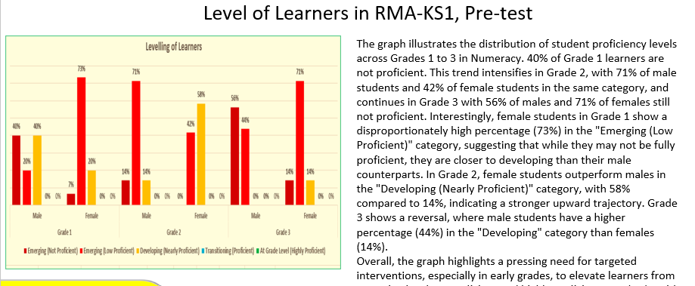
Report on Key Performance Indicators
SAMPLE

Slide 35
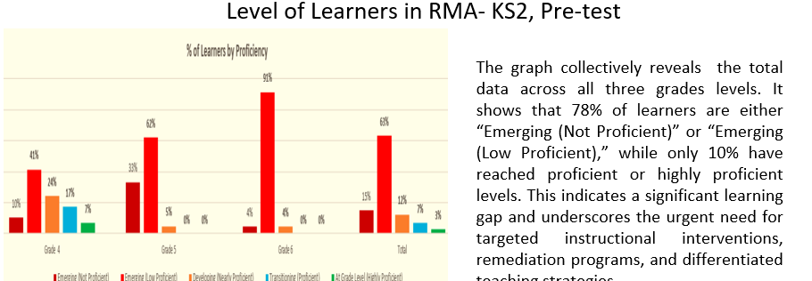
Report on Key Performance Indicators
SAMPLE

Slide 36
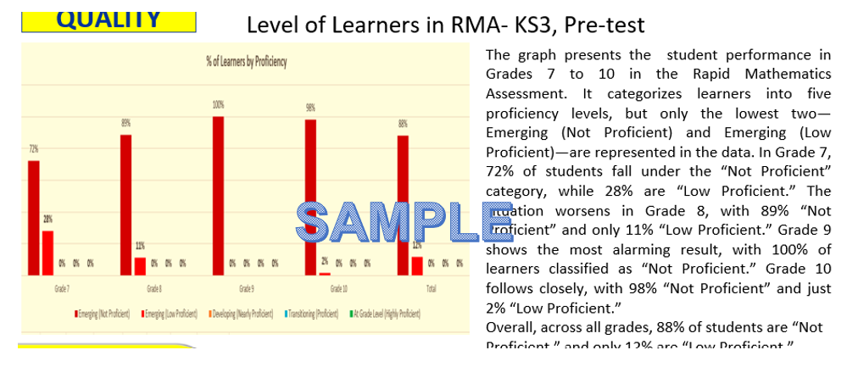
Report on Key Performance Indicators

Slide 37
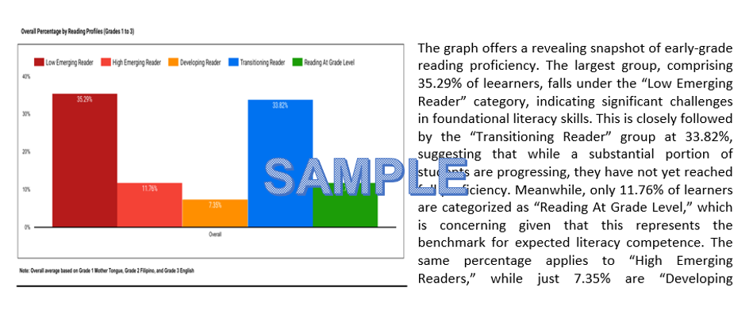
Report on Key Performance Indicators
CRLA Pre-test Results

Slide 38
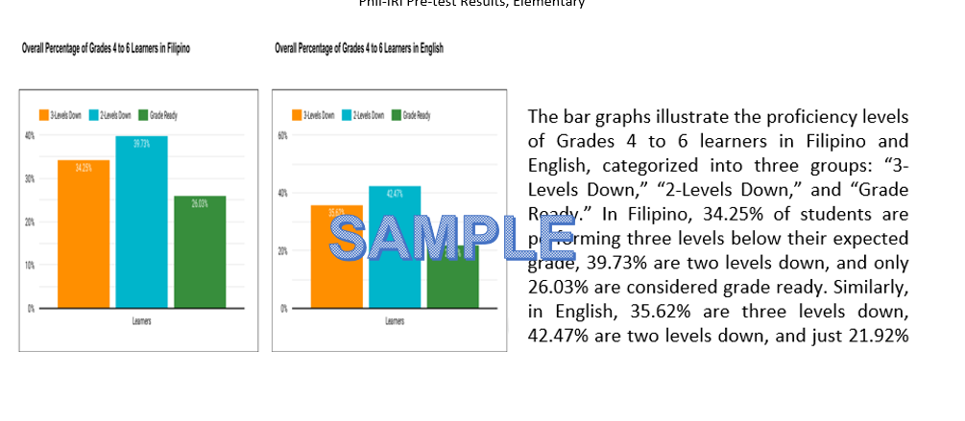
Report on Key Performance Indicators
Phil-IRI Pre-test Results, Elementary

Slide 39
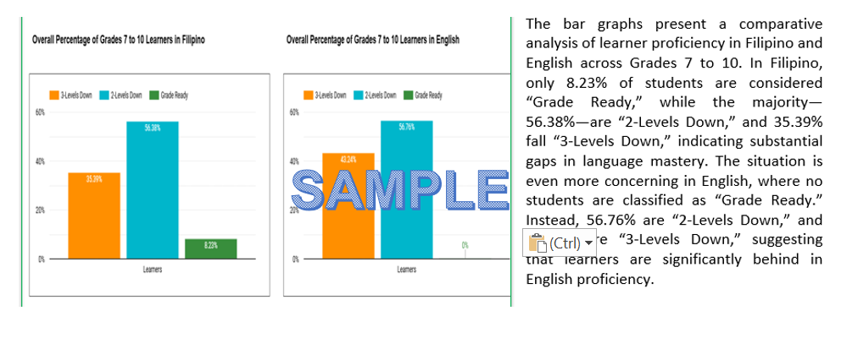
Report on Key Performance Indicators
Phil-IRI Pre-test Results, JHS

