Slide 1
TITLE PAGE, DISTRICT NAME, LOGO, DISTRICT IDENTITY DESIGN-COLOR

Slide 2
Physical & Financial Accomplishment Report
KRA_1_INSTRUCTIONAL_SUPERVISION
1. Provide guidance and instructional supervision to school heads by observing and gathering data on their strengths and development needs and then coaching them towards improved instructional leadership practices.
PAPs | PHYSICAL ACCOMPLISHMENTS |  |  |  |  |  |  | FINANCIAL ACCOMPLISHMENTS |  |  |  |  | MOVs
 | Targets | Accomplishments | Gain (if any) | Gap (if any) | Total Accomplishment | % of Accomplishments | Remarks | Targets | Actual Accomplishments | Variance | % of Accomplishments | Remarks
 |  |  |  |  |  |  |  |  |  |  |  |  | Provide a hyperlink to view the MOVs
 |  |  |  |  |  |  |  |  |  |  |  |  | Provide a hyperlink to view the MOVs

Slide 3
Physical & Financial Accomplishment Report
KRA_1_INSTRUCTIONAL_SUPERVISION
2. Observe and gather data on the strengths and competency (KSA) development needs of teachers and coach school heads on how to improve teachers' KSA in teaching-learning delivery.
PAPs | PHYSICAL ACCOMPLISHMENTS |  |  |  |  |  |  | FINANCIAL ACCOMPLISHMENTS |  |  |  |  | MOVs
 | Targets | Accomplishments | Gain (if any) | Gap (if any) | Total Accomplishment | % of Accomplishments | Remarks | Targets | Actual Accomplishments | Variance | % of Accomplishments | Remarks
 |  |  |  |  |  |  |  |  |  |  |  |  | Provide a hyperlink to view the MOVs
 |  |  |  |  |  |  |  |  |  |  |  |  | Provide a hyperlink to view the MOVs

Slide 4
Physical & Financial Accomplishment Report
KRA_1_INSTRUCTIONAL_SUPERVISION
3. Assess the situation of schools and learning centers, and identify actions needed to put in place an enabling environment for School Heads and Teachers to deliver quality basic education
PAPs | PHYSICAL ACCOMPLISHMENTS |  |  |  |  |  |  | FINANCIAL ACCOMPLISHMENTS |  |  |  |  | MOVs
 | Targets | Accomplishments | Gain (if any) | Gap (if any) | Total Accomplishment | % of Accomplishments | Remarks | Targets | Actual Accomplishments | Variance | % of Accomplishments | Remarks
 |  |  |  |  |  |  |  |  |  |  |  |  | Provide a hyperlink to view the MOVs
 |  |  |  |  |  |  |  |  |  |  |  |  | Provide a hyperlink to view the MOVs

Slide 5
Physical & Financial Accomplishment Report
KRA_2_TECHNICAL_ASSISTANCE_IN_SCHOOL_MANAGEMENT
1. Provide technical assistance in the formulation of school plans (e.g. SIP) and its adjustments by conducting workshops, doing follow through coaching and providing appraisal and feedback on their draft plans, so that all schools can have approved plans as basis for budgeting and resourcing,
PAPs | PHYSICAL ACCOMPLISHMENTS |  |  |  |  |  |  | FINANCIAL ACCOMPLISHMENTS |  |  |  |  | MOVs
 | Targets | Accomplishments | Gain (if any) | Gap (if any) | Total Accomplishment | % of Accomplishments | Remarks | Targets | Actual Accomplishments | Variance | % of Accomplishments | Remarks
 |  |  |  |  |  |  |  |  |  |  |  |  | Provide a hyperlink to view the MOVs
 |  |  |  |  |  |  |  |  |  |  |  |  | Provide a hyperlink to view the MOVs

Slide 6
Physical & Financial Accomplishment Report
KRA_2_TECHNICAL_ASSISTANCE_IN_SCHOOL_MANAGEMENT
2. Monitor and evaluate school's implementation of their plans and submit reports to the Schools Division management team to provide feedback
PAPs | PHYSICAL ACCOMPLISHMENTS |  |  |  |  |  |  | FINANCIAL ACCOMPLISHMENTS |  |  |  |  | MOVs
 | Targets | Accomplishments | Gain (if any) | Gap (if any) | Total Accomplishment | % of Accomplishments | Remarks | Targets | Actual Accomplishments | Variance | % of Accomplishments | Remarks
 |  |  |  |  |  |  |  |  |  |  |  |  | Provide a hyperlink to view the MOVs
 |  |  |  |  |  |  |  |  |  |  |  |  | Provide a hyperlink to view the MOVs

Slide 7
Physical & Financial Accomplishment Report
KRA_2_TECHNICAL_ASSISTANCE_IN_SCHOOL_MANAGEMENT
3. Coach and guide the schools in his/her assigned district to effectively implement their programs and projects and attain its objectives.
PAPs | PHYSICAL ACCOMPLISHMENTS |  |  |  |  |  |  | FINANCIAL ACCOMPLISHMENTS |  |  |  |  | MOVs
 | Targets | Accomplishments | Gain (if any) | Gap (if any) | Total Accomplishment | % of Accomplishments | Remarks | Targets | Actual Accomplishments | Variance | % of Accomplishments | Remarks
 |  |  |  |  |  |  |  |  |  |  |  |  | Provide a hyperlink to view the MOVs
 |  |  |  |  |  |  |  |  |  |  |  |  | Provide a hyperlink to view the MOVs

Slide 8
Physical & Financial Accomplishment Report
KRA_2_TECHNICAL_ASSISTANCE_IN_SCHOOL_MANAGEMENT
4. Coordinate and facilitate the conduct of orientation/ induction programs for al newly hired teachers on their roles and responsibilities.
PAPs | PHYSICAL ACCOMPLISHMENTS |  |  |  |  |  |  | FINANCIAL ACCOMPLISHMENTS |  |  |  |  | MOVs
 | Targets | Accomplishments | Gain (if any) | Gap (if any) | Total Accomplishment | % of Accomplishments | Remarks | Targets | Actual Accomplishments | Variance | % of Accomplishments | Remarks
 |  |  |  |  |  |  |  |  |  |  |  |  | Provide a hyperlink to view the MOVs
 |  |  |  |  |  |  |  |  |  |  |  |  | Provide a hyperlink to view the MOVs

Slide 9
Physical & Financial Accomplishment Report
KRA_2_TECHNICAL_ASSISTANCE_IN_SCHOOL_MANAGEMENT
5. Collect and analyze accomplishment reports of school heads to monitor and follow up on the proper and timely implementation of school plans and programs and provide technical assistance where needed.
PAPs | PHYSICAL ACCOMPLISHMENTS |  |  |  |  |  |  | FINANCIAL ACCOMPLISHMENTS |  |  |  |  | MOVs
 | Targets | Accomplishments | Gain (if any) | Gap (if any) | Total Accomplishment | % of Accomplishments | Remarks | Targets | Actual Accomplishments | Variance | % of Accomplishments | Remarks
 |  |  |  |  |  |  |  |  |  |  |  |  | Provide a hyperlink to view the MOVs
 |  |  |  |  |  |  |  |  |  |  |  |  | Provide a hyperlink to view the MOVs

Slide 10
Physical & Financial Accomplishment Report
KRA_3_MONITORING_AND_EVALUATION
1. Conduct monitoring and evaluation on the utilization and liquidation of SEF, MOOE and other funds to determine if schools adhere with the policy and standards using pre-designed M & E and transparency tools.
PAPs | PHYSICAL ACCOMPLISHMENTS |  |  |  |  |  |  | FINANCIAL ACCOMPLISHMENTS |  |  |  |  | MOVs
 | Targets | Accomplishments | Gain (if any) | Gap (if any) | Total Accomplishment | % of Accomplishments | Remarks | Targets | Actual Accomplishments | Variance | % of Accomplishments | Remarks
 |  |  |  |  |  |  |  |  |  |  |  |  | Provide a hyperlink to view the MOVs
 |  |  |  |  |  |  |  |  |  |  |  |  | Provide a hyperlink to view the MOVs

Slide 11
Physical & Financial Accomplishment Report
KRA_3_MONITORING_AND_EVALUATION
2. Monitor SBM Level of practice through validation of their documents and outputs to determine areas for development and possible provision of technical assistance to improve school performance.
PAPs | PHYSICAL ACCOMPLISHMENTS |  |  |  |  |  |  | FINANCIAL ACCOMPLISHMENTS |  |  |  |  | MOVs
 | Targets | Accomplishments | Gain (if any) | Gap (if any) | Total Accomplishment | % of Accomplishments | Remarks | Targets | Actual Accomplishments | Variance | % of Accomplishments | Remarks
 |  |  |  |  |  |  |  |  |  |  |  |  | Provide a hyperlink to view the MOVs
 |  |  |  |  |  |  |  |  |  |  |  |  | Provide a hyperlink to view the MOVs

Slide 12
Physical & Financial Accomplishment Report
KRA_3_MONITORING_AND_EVALUATION
3. Monitor and evaluate private schools through ocular inspection of required documents to determine adherence to set standards as regards to permit to operate renewal of operation, permit for recognition, GASTPE implementation, accreditation
PAPs | PHYSICAL ACCOMPLISHMENTS |  |  |  |  |  |  | FINANCIAL ACCOMPLISHMENTS |  |  |  |  | MOVs
 | Targets | Accomplishments | Gain (if any) | Gap (if any) | Total Accomplishment | % of Accomplishments | Remarks | Targets | Actual Accomplishments | Variance | % of Accomplishments | Remarks
 |  |  |  |  |  |  |  |  |  |  |  |  | Provide a hyperlink to view the MOVs
 |  |  |  |  |  |  |  |  |  |  |  |  | Provide a hyperlink to view the MOVs

Slide 13
Physical & Financial Accomplishment Report
KRA_4_CURRICULUM_DEVELOPMENT__ENRICHMENT_AND_LOCALIZATION
1. Conduct monitoring and evaluation of the school's implementation of the localized curriculum to provide feedback to management towards continuous enhancement of the curriculum.
PAPs | PHYSICAL ACCOMPLISHMENTS |  |  |  |  |  |  | FINANCIAL ACCOMPLISHMENTS |  |  |  |  | MOVs
 | Targets | Accomplishments | Gain (if any) | Gap (if any) | Total Accomplishment | % of Accomplishments | Remarks | Targets | Actual Accomplishments | Variance | % of Accomplishments | Remarks
 |  |  |  |  |  |  |  |  |  |  |  |  | Provide a hyperlink to view the MOVs
 |  |  |  |  |  |  |  |  |  |  |  |  | Provide a hyperlink to view the MOVs

Slide 14
Physical & Financial Accomplishment Report
KRA_5_LEARNING_OUTCOMES_ASSESSMENT
1. Gather result of assessment reports per district and per school, per subject area and analyze performance gaps to pinpoint causes and possible interventions to close the gap.
PAPs | PHYSICAL ACCOMPLISHMENTS |  |  |  |  |  |  | FINANCIAL ACCOMPLISHMENTS |  |  |  |  | MOVs
 | Targets | Accomplishments | Gain (if any) | Gap (if any) | Total Accomplishment | % of Accomplishments | Remarks | Targets | Actual Accomplishments | Variance | % of Accomplishments | Remarks
 |  |  |  |  |  |  |  |  |  |  |  |  | Provide a hyperlink to view the MOVs
 |  |  |  |  |  |  |  |  |  |  |  |  | Provide a hyperlink to view the MOVs

Slide 15
Physical & Financial Accomplishment Report
KRA_5_LEARNING_OUTCOMES_ASSESSMENT
2. Draft policy recommendations related to improving learning outcome based on findings from studies and reports.
PAPs | PHYSICAL ACCOMPLISHMENTS |  |  |  |  |  |  | FINANCIAL ACCOMPLISHMENTS |  |  |  |  | MOVs
 | Targets | Accomplishments | Gain (if any) | Gap (if any) | Total Accomplishment | % of Accomplishments | Remarks | Targets | Actual Accomplishments | Variance | % of Accomplishments | Remarks
 |  |  |  |  |  |  |  |  |  |  |  |  | Provide a hyperlink to view the MOVs
 |  |  |  |  |  |  |  |  |  |  |  |  | Provide a hyperlink to view the MOVs

Slide 16
Physical & Financial Accomplishment Report
KRA_6_RESEARCH
1. Conduct action research on curriculum implementation, needs and issues, appropriate interventions for assigned district as well as best practices and submit findings and recommendations for management action and policy formulation.
PAPs | PHYSICAL ACCOMPLISHMENTS |  |  |  |  |  |  | FINANCIAL ACCOMPLISHMENTS |  |  |  |  | MOVs
 | Targets | Accomplishments | Gain (if any) | Gap (if any) | Total Accomplishment | % of Accomplishments | Remarks | Targets | Actual Accomplishments | Variance | % of Accomplishments | Remarks
 |  |  |  |  |  |  |  |  |  |  |  |  | Provide a hyperlink to view the MOVs
 |  |  |  |  |  |  |  |  |  |  |  |  | Provide a hyperlink to view the MOVs

Slide 17
Physical & Financial Accomplishment Report
KRA_7_TECHNICAL_ASSISTANCE
1. Assesses the situation and analyzes the needs of schools in the district to identify the appropriate and relevant actions and interventions
PAPs | PHYSICAL ACCOMPLISHMENTS |  |  |  |  |  |  | FINANCIAL ACCOMPLISHMENTS |  |  |  |  | MOVs
 | Targets | Accomplishments | Gain (if any) | Gap (if any) | Total Accomplishment | % of Accomplishments | Remarks | Targets | Actual Accomplishments | Variance | % of Accomplishments | Remarks
 |  |  |  |  |  |  |  |  |  |  |  |  | Provide a hyperlink to view the MOVs
 |  |  |  |  |  |  |  |  |  |  |  |  | Provide a hyperlink to view the MOVs

Slide 18
Physical & Financial Accomplishment Report
KRA_7_TECHNICAL_ASSISTANCE
2. Coordinate with the EPS concerned to arrive at a technical assistance plan for each district.
PAPs | PHYSICAL ACCOMPLISHMENTS |  |  |  |  |  |  | FINANCIAL ACCOMPLISHMENTS |  |  |  |  | MOVs
 | Targets | Accomplishments | Gain (if any) | Gap (if any) | Total Accomplishment | % of Accomplishments | Remarks | Targets | Actual Accomplishments | Variance | % of Accomplishments | Remarks
 |  |  |  |  |  |  |  |  |  |  |  |  | Provide a hyperlink to view the MOVs
 |  |  |  |  |  |  |  |  |  |  |  |  | Provide a hyperlink to view the MOVs

Slide 19
Physical & Financial Accomplishment Report
KRA_7_TECHNICAL_ASSISTANCE
3. Coach the school head in implementing interventions related to curriculum implementation and instructional delivery.
PAPs | PHYSICAL ACCOMPLISHMENTS |  |  |  |  |  |  | FINANCIAL ACCOMPLISHMENTS |  |  |  |  | MOVs
 | Targets | Accomplishments | Gain (if any) | Gap (if any) | Total Accomplishment | % of Accomplishments | Remarks | Targets | Actual Accomplishments | Variance | % of Accomplishments | Remarks
 |  |  |  |  |  |  |  |  |  |  |  |  | Provide a hyperlink to view the MOVs
 |  |  |  |  |  |  |  |  |  |  |  |  | Provide a hyperlink to view the MOVs

Slide 20
Physical & Financial Accomplishment Report
KRA_7_TECHNICAL_ASSISTANCE
4. Prepares and submits periodic reports on the progress of the technical assistance being provided to the schools
PAPs | PHYSICAL ACCOMPLISHMENTS |  |  |  |  |  |  | FINANCIAL ACCOMPLISHMENTS |  |  |  |  | MOVs
 | Targets | Accomplishments | Gain (if any) | Gap (if any) | Total Accomplishment | % of Accomplishments | Remarks | Targets | Actual Accomplishments | Variance | % of Accomplishments | Remarks
 |  |  |  |  |  |  |  |  |  |  |  |  | Provide a hyperlink to view the MOVs
 |  |  |  |  |  |  |  |  |  |  |  |  | Provide a hyperlink to view the MOVs

Slide 21
Physical & Financial Accomplishment Report
KRA_7_TECHNICAL_ASSISTANCE
5. Prepares and submits reports on the results of technical assistance and corresponding policy recommendations for management's consideration.
PAPs | PHYSICAL ACCOMPLISHMENTS |  |  |  |  |  |  | FINANCIAL ACCOMPLISHMENTS |  |  |  |  | MOVs
 | Targets | Accomplishments | Gain (if any) | Gap (if any) | Total Accomplishment | % of Accomplishments | Remarks | Targets | Actual Accomplishments | Variance | % of Accomplishments | Remarks
 |  |  |  |  |  |  |  |  |  |  |  |  | Provide a hyperlink to view the MOVs
 |  |  |  |  |  |  |  |  |  |  |  |  | Provide a hyperlink to view the MOVs

Slide 22
PART_I_C_ORGANIZATIONAL_EFFECTIVENESS
SUMMARY
OPCR-KRA | PHYSICAL ACCOMPLISHMENTS |  |  |  |  |  | FINANCIAL ACCOMPLISHMENTS
 | Targets | Accomplishments | Gain (if any) | Gap (if any) | Total Accomplishment | % of Accomplishments | Targets | Actual Accomplishments | Variance | % of Accomplishments
KRA_1_INSTRUCTIONAL_SUPERVISION
KRA_2_TECHNICAL_ASSISTANCE_IN_SCHOOL_MANAGEMENT
KRA_3_MONITORING_AND_EVALUATION
KRA_4_CURRICULUM_DEVELOPMENT__ENRICHMENT_AND_LOCALIZATION
KRA_5_LEARNING_OUTCOMES_ASSESSMENT
KRA_6_RESEARCH
KRA_7_TECHNICAL_ASSISTANCE
TOTAL

Slide 23
Unaccomplished PAPs
and Adjustment Plan
Unaccomplished PAPs |  |  |  |  |  | Adjustment Plan
KRA | Unaccomplished Outputs (Gaps) | Physical Target | Financial Target | Reasons for the Gaps | Recommendation (Drop, Carry Over, Modify) | Proposed Action | Office-in-Charge | Target date of Completion
 | 0 | 0 | 0 | 0 | 0 | 0 | 0 | 0

Slide 24
Implementation Concerns, Issues, Gaps, & Problems (CIGPs) and Proposed Resolutions
Unaccomplished PAPs |  |  |  |  |  | Adjustment Plan
KRA | Unaccomplished Outputs (Gaps) | Physical Target | Financial Target | Reasons for the Gaps | Recommendation (Drop, Carry Over, Modify) | Proposed Action | Office-in-Charge | Target date of Completion
 | 0 | 0 | 0 | 0 | 0 | 0 | 0 | 0

Slide 25
Implementation Concerns, Issues, Gaps, & Problems (CIGPs) and Proposed Resolutions
Unaccomplished PAPs |  |  |  |  |  | Adjustment Plan
KRA | Unaccomplished Outputs (Gaps) | Physical Target | Financial Target | Reasons for the Gaps | Recommendation (Drop, Carry Over, Modify) | Proposed Action | Office-in-Charge | Target date of Completion
 | 0 | 0 | 0 | 0 | 0 | 0 | 0 | 0

Slide 26
Effective Practices

Slide 27

Insert Drive Link of the MOVs
Monthly Scorecard: Learning Recovery (Literacy & Numeracy)
Indicator | Definition / What It Measures | Data Source | Target | Current Month | Previous Month | Trend | Remarks / Action Needed
% of learners at or above grade-level reading | Proportion of learners who meet or exceed expected reading level for their grade | Reading assessment results (Phil-IRI / school tools) | ≥ ___% | ___% | ___% | Improving / Stable / Declining
% of learners meeting numeracy benchmarks | Learners achieving grade-level numeracy competencies | Math assessment / numeracy tests | ≥ ___% | ___% | ___% | Improving / Stable / Declining
Number of learners receiving remediation | Total learners enrolled in reading and numeracy remediation programs | School remediation records | 100% of identified learners | ___ | ___ | Improving / Stable / Declining
Frequency of reading and numeracy interventions | Number of structured reading/numeracy sessions conducted per month | School intervention logs | ≥ ___ sessions/month | ___ | ___ | Improving / Stable / Declining
Overall monthly learning trend | Summary analysis of progress based on all indicators | Division/District analysis | Improving | — | — | Improving / Stable / Declining

Slide 28

Monthly Scorecard: Teacher Support & Welfare
Insert Drive Link of the MOVs
Indicator | Definition / What It Measures | Data Source | Target | Current Month | Previous Month | Trend | Remarks / Action Needed
% reduction in non-teaching tasks | Decrease in administrative and non-instructional tasks assigned to teachers | Task mapping / school reports | ≥ ___% reduction | ___% | ___% | Improving / Stable / Declining
Number of teachers receiving coaching/mentoring | Teachers provided with classroom-based coaching, mentoring, or peer support | Coaching logs / LAC records | ≥ ___ teachers | ___ | ___ | Improving / Stable / Declining
INSET & LAC relevance rating | Average teacher satisfaction rating on relevance and usefulness of INSET/LAC | Teacher feedback surveys | ≥ ___ / 5 | ___ / 5 | ___ / 5 | Improving / Stable / Declining
Teacher attendance rate | Percentage of teachers present and engaged during school days | Attendance records | ≥ ___% | ___% | ___% | Improving / Stable / Declining
Teacher morale indicator | Qualitative/quantitative indicator of motivation and well-being | Survey / school head observation | Positive | — | — | Improving / Stable / Declining
Support actions implemented this month | Specific support interventions provided to teachers | School & district action logs | 100% planned actions | ___ actions | ___ actions | Improving / Stable / Declining

Slide 29
Insert Drive Link of the MOVs
Monthly Scorecard: School Leadership & Governance
Indicator | Definition / What It Measures | Data Source | Target | Current Month | Previous Month | Trend | Remarks / Action Needed
% of schools with SIP/AIP aligned to learner data | Proportion of schools whose SIP/AIP targets are based on current learner performance data | SIP/AIP review reports | 100% | ___% | ___% | Improving / Stable / Declining
Number of instructional walkthroughs conducted | Total classroom observations focused on instruction and learner engagement | Walkthrough logs (PSDS/EPS) | ≥ ___ per month | ___ | ___ | Improving / Stable / Declining
Issues raised vs. issues resolved in MANCOM | Comparison of concerns elevated in MANCOM against those resolved within the month | MANCOM minutes and action tracker | ≥ ___% resolution | ___ / ___ | ___ / ___ | Improving / Stable / Declining
Timeliness of reports | Percentage of required reports submitted on or before deadline | Report submission tracker | ≥ ___% on time | ___% | ___% | Improving / Stable / Declining
Timeliness of decisions | Percentage of decisions acted upon within agreed timelines | MANCOM decision log | ≥ ___% | ___% | ___% | Improving / Stable / Declining
Leadership actions for next month | Specific leadership interventions planned based on scorecard results | MANCOM action plan | 100% identified | ___ actions | ___ actions | Improving / Stable / Declining

Slide 30
Insert Drive Link of the MOVs
Monthly Scorecard: Learning Environment & Infrastructure
Indicator | Definition / What It Measures | Data Source | Target | Current Month | Previous Month | Trend | Remarks / Priority Action
Classroom–pupil ratio | Average number of learners per classroom | School inventory / EBEIS | ≤ ___ : 1 | ___ : 1 | ___ : 1 | Improving / Stable / Declining
% of classrooms needing repair | Proportion of classrooms requiring minor or major repair | School facilities assessment | ≤ ___% | ___% | ___% | Improving / Stable / Declining
Internet availability | Percentage of schools with functional internet connection | ICT / school reports | 100% | ___% | ___% | Improving / Stable / Declining
Electricity availability | Percentage of schools with stable electricity | School utilities report | 100% | ___% | ___% | Improving / Stable / Declining
LGU-supported infrastructure actions | Number of infrastructure projects supported by LGUs this month | LGU–DepEd coordination reports | ≥ ___ actions | ___ | ___ | Improving / Stable / Declining
Priority schools for intervention | Schools identified for immediate infrastructure support | Division/SGOD analysis | All identified covered | ___ schools | ___ schools | Improving / Stable / Declining

Slide 31

Insert Drive Link of the MOVs
Monthly Scorecard: LGU & Community Engagement
Indicator | Definition / What It Measures | Data Source | Target | Current Month | Previous Month | Trend | Remarks / Strategic Action
SEF utilization aligned to learning priorities | Percentage of SEF expenditures supporting literacy, numeracy, teacher support, and facilities | SEF financial reports / LSB records | ≥ ___% aligned | ___% | ___% | Improving / Stable / Declining
Active LGU and community partnerships | Number of ongoing partnerships supporting schools | MOAs / partnership database | ≥ ___ partnerships | ___ | ___ | Improving / Stable / Declining
Local School Board meetings conducted | Number of LSB meetings held as scheduled | LSB minutes | ≥ ___ per quarter | ___ | ___ | Improving / Stable / Declining
Community-supported education initiatives | Programs or projects funded or supported by community groups | School and LGU reports | ≥ ___ initiatives | ___ | ___ | Improving / Stable / Declining
Next partnership targets | Identified LGUs, NGOs, or private partners for eng

Slide 32
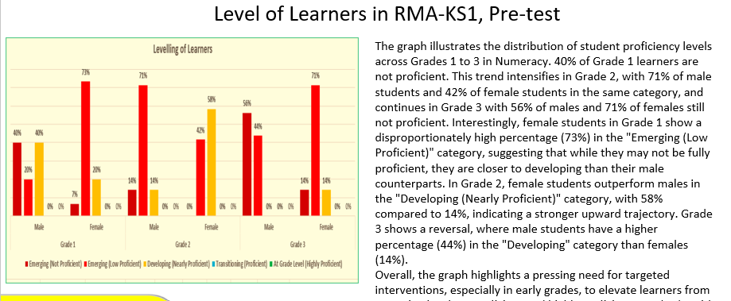
Report on Key Performance Indicators
SAMPLE

Slide 33
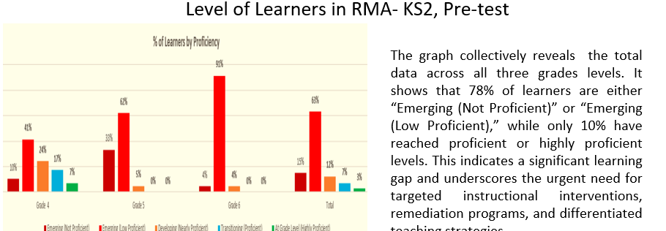
Report on Key Performance Indicators
SAMPLE

Slide 34
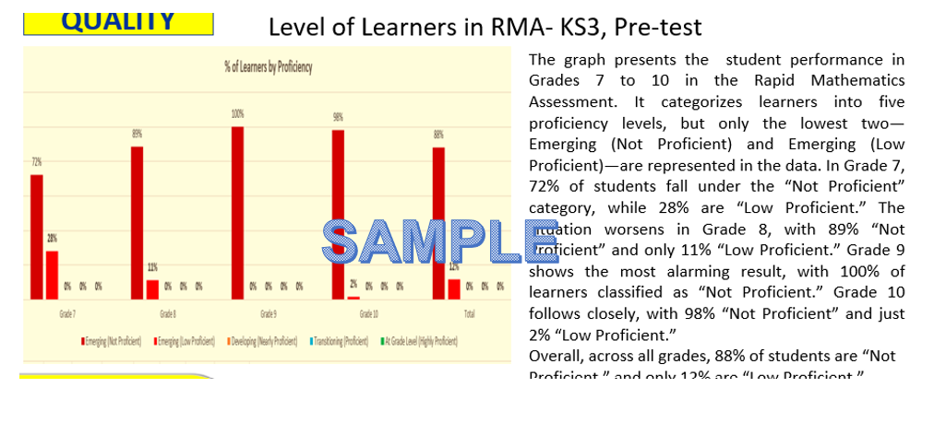
Report on Key Performance Indicators

Slide 35
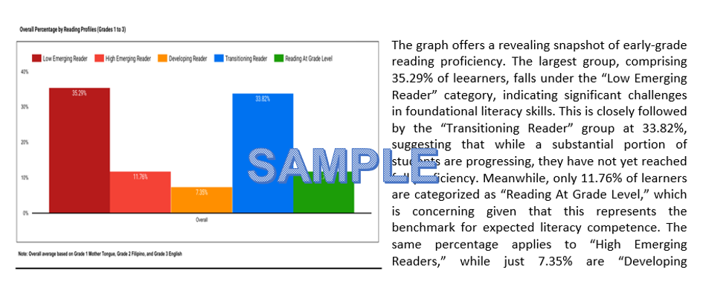
Report on Key Performance Indicators
CRLA Pre-test Results

Slide 36
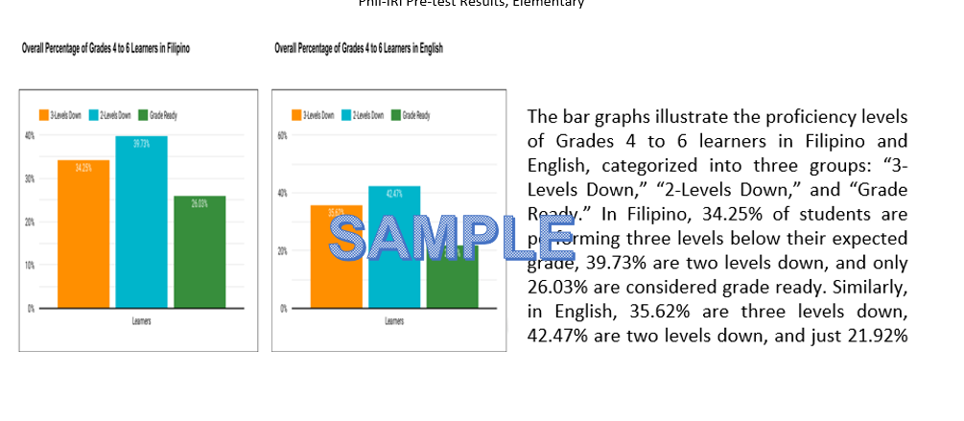
Report on Key Performance Indicators
Phil-IRI Pre-test Results, Elementary

Slide 37
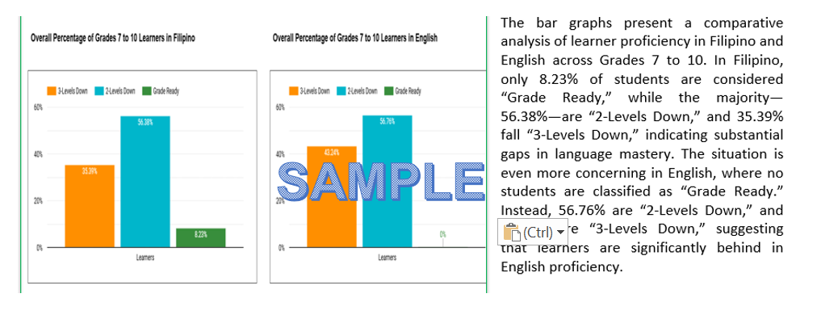
Report on Key Performance Indicators
Phil-IRI Pre-test Results, JHS

